Slide 1
We’re going to build an application
We will do this by using AJAX in 3 ways
XMLHttpRequest()
Fetch()
Axios
But, before we can start writing AJAX, we need to do a few things

Slide 2



What are some things we need to create?
Frontend (browser)
Backend (server)
In real life, we would have a database to save all data into. This course is about AJAX (frontend) so we will not create a DB. This means every time you restart your server, the data will be lost.

Slide 3

What are some things we need to create?
Frontend (browser)
Backend (server)
In real life, we would have a database to save all data into. This course is about AJAX (frontend) so we will not create a DB. This means every time you restart your server, the data will be lost.

Slide 4
What are some things we need to create?
Frontend (browser)
Backend (server)
APIs
In real life, we would have a database to save all data into. This course is about AJAX (frontend) so we will not create a DB. This means every time you restart your server, the data will be lost.

Slide 5
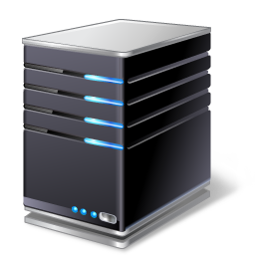

??
We will be creating RESTful endpoints that all user interactions get sent to
Get a list of all dogs / users in my system
Update an existing dog / user on my system
Delete an existing dog / user on my system
Add a new dog / user on my system
Each different action your user takes, needs to be sent to a unique location on the server, so the server knows what to do.

Slide 6
We will be creating RESTful endpoints that all requests get sent to
The way you send information to the server is up to you
The modern and most intuitive way is using RESTful endpoints

Slide 7
HTTP
Get a list of all dogs / users in my system
Update an existing dog / user on my system
Delete an existing dog / user on my system
Add a new dog / user on my system
Don’t freak out. REST is just a way to use the HTTP protocol
REST is just a document (specification) outlining how you should define endpoints. If you follow these guidelines, then your application conforms with REST

Slide 8
Bottom line: we will define a set of URL endpoints that conform to REST, whereby the client and server can communicate
A lot of developers just use a simple GET request or POST request
But, REST says you should be descriptive

Slide 9
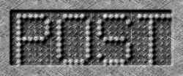
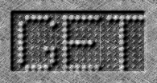

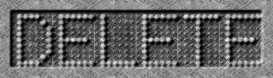
=> Add data to our server
Create
=> Get data from server
Read
=> Update something
Update
=> Delete something
Delete

Slide 10


GET /users/update/:ID
Not restful
PUT /users/update/:ID
Restful
REST says we should use PUT because it better describes what we’re doing

Slide 11
DELETE /users/delete
Not restful
DELETE /users/delete/:ID
Restful
REST says we should include the user’s ID because it is more intuitive

Slide 12
For a website to function, you need both frontend and backend code
The frontend consists of HTML, CSS and AJAX
In this course, the backend will consist of a Node.js server
TASK 1
TASK 2
TASK 3
Set up server
Create HTML and CSS
Set up AJAX endpoints

